Slide 1
Data Movement Is All You Need: A Case Study on Optimizing Transformers [1]
I. Background and challenges
III. Results
Signiﬁcant performance improvements
Transformers are becoming the dominant task for machine learning.
The transformer architecture consists of two main components: multi-head attention (MHA) and a feed-forward network.
Training has become memory-bound; Data movement is the key bottleneck when training transformers.
Existing frameworks use suboptimal data layouts.
Existing implementations do not efﬁciently utilize GPUs.
Reduce data movement overheads by up to 22.91% over existing implementations
Achieve at least 1.08 × performance improvements over specialized libraries
1.30 × over general-purpose frameworks
Model | Saving
Robustly training BERT [3] | $85,000
GPT-3 transformer [4] | $3,600,000 (training cost $12M) [5]
II. Methods (a summary)
Globally optimizing data movement
Construct a dataﬂow graph for the training process and use it to identify operator dependency patterns and data volume.
Identify opportunities for data movement reduction to guide optimization using the dataflow graph.
Maximize data reuse using fusion.
Select performant data layouts for normalization and tensor contraction operators.
Produce an optimized end-to-end implementation based on the above steps.
The paper uses particular transformer models as examples, but its methods are applicable to other DNN models and architectures.
[1] https://arxiv.org/abs/2007.00072
[2] https://github.com/spcl/substation
[3] https://arxiv.org/abs/1907.11692
[4] https://arxiv.org/abs/2005.14165
[5] https://venturebeat.com/ai/ai-machine-learning-openai-gpt-3-size-isnt-everything/

Slide 2
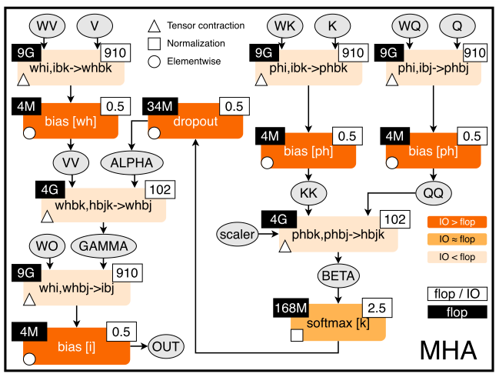
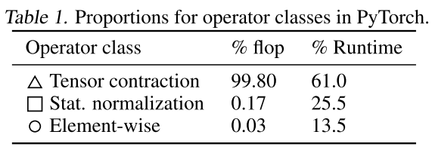
Data Movement Is All You Need: A Case Study on Optimizing Transformers [1]
II. Methods
1. Optimizing transformers
Operator classes
* Construct a dataﬂow graph for training and analyze the
computation to identify common operator classes.
* Develop a generic recipe for optimizing training using dataﬂow analyses.
* Using the recipe, systematically explore performance of operators and the beneﬁts of different optimizations.
Dataflow and optimizer classification
Tensor Contractions: △ These are matrix-matrix multiplications (MMMs).
Statistical Normalizations: ⬜ These are operators such as softmax and layer normalization.
Element-wise Operators ○ These are the remaining operators: biases, dropout, activations, and residual connections.
Figure 1. Input code and stateful dataﬂow multigraph (SDFG) for Multi-Head Attention. Throughout the paper, if not stated otherwise, the values are given for the following set of parameters: P = W = 64, H = 16, I = P ⋅ H = 1024, B = 8, J = K = 512. P/W: key/value projection size; H: # heads; I: embedding size; B: batch size; J/K: input/output sequence length.
* flop: ﬂoating point operations

Slide 3
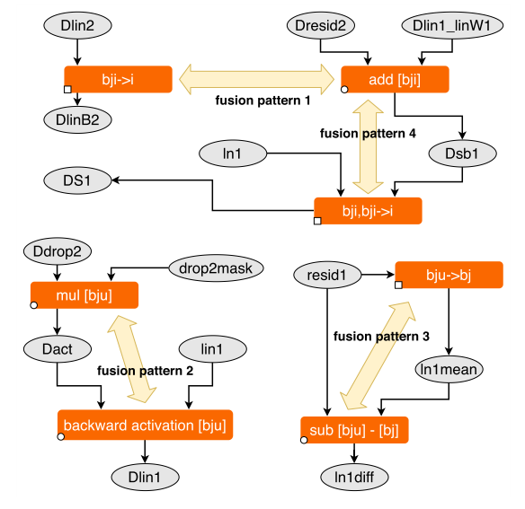
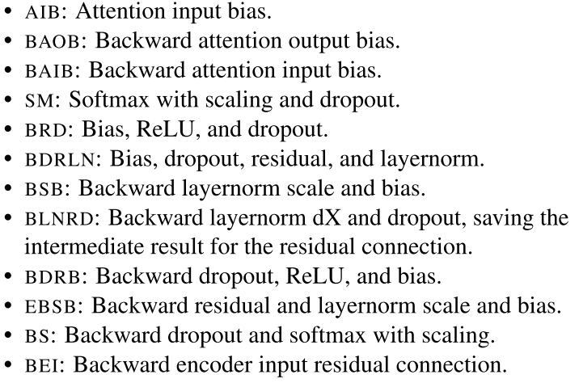
Data Movement Is All You Need: A Case Study on Optimizing Transformers [1]
III. Methods
2. Fusion
Step 1: two operators can be fused if their iteration space implementations are compatible: they are either the same or the only difference is that one operator performs a reduction.
Fusion is a major opportunity for promoting data reuse. It puts multiple operators together to reuse the input/output data.
Step2: When a fusion opportunity is detected, decide: 1, if fewer kernel launches by merging iteration spaces; 2, if less data movement by avoiding loads and stores between operators.
Fusion consists of two steps: step 1. detecting which operations can be fused, step 2. deciding whether it is beneﬁcial to fuse them.
Perform fusion using the SDFG, two adjacent operators are fused until either a reduction dimension or iteration space changes.
Each fused operator is implemented as a CUDA kernel specialized for a speciﬁc data layout.

Slide 4
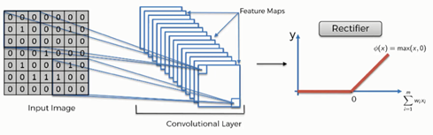
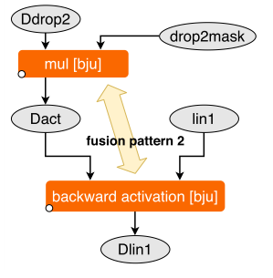
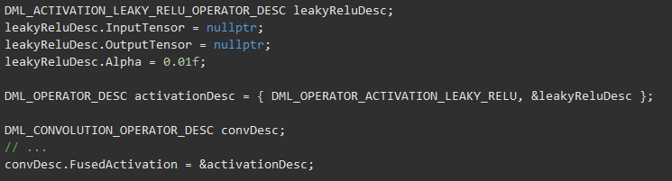
Data Movement Is All You Need: A Case Study on Optimizing Transformers [1]
Example from paper [1]
III. Methods
2. Fusion
Step 1: detecting which operations can be fused.
As shown here, “Ddrop2” and “drop2mask” are processed with operator “mul” (multiplication) in size “bju” ; the result of “mul” will be processed with “lin1” by backward activation. These two operators are elementwise and have the same size “bju”, so they can be fused.
Definition: Operator fusion is a way to improve performance by merging one operator into a different operator so that they are executed together without requiring a roundtrip to memory.[6]
Example: fusion of a Convolution and a Relu activation.
Image source [7]
Same size
Elementwise
operator
Code: using DirectML[6]
Operators
Step2: deciding whether it is beneﬁcial to fuse them. After fusion, less data movement by avoiding loads and stores between operators.
[6] https://learn.microsoft.com/en-us/windows/ai/directml/dml-fused-activations
[7] https://www.superdatascience.com/blogs/convolutional-neural-networks-cnn-step-1b-relu-layer
Fusion

Slide 5
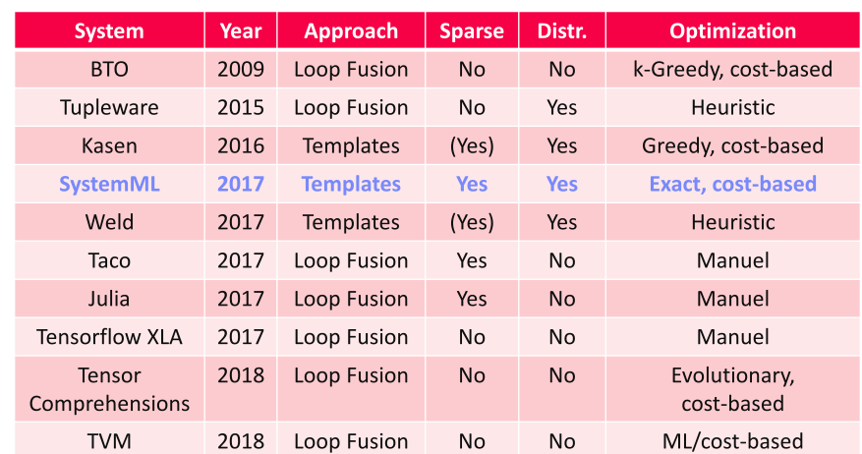
Data Movement Is All You Need: A Case Study on Optimizing Transformers [1]
III. Methods
2. Fusion
Operator Fusion System (in General) [13]
[13] https://mboehm7.github.io/teaching/ss19_amls/04_AdvancedCompilation.pdf

Slide 6
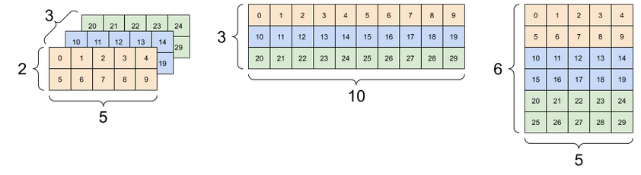
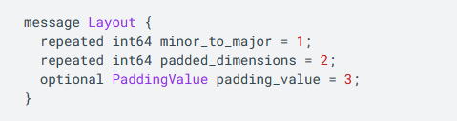
Data Movement Is All You Need: A Case Study on Optimizing Transformers [1]
III. Solutions
3. Data layout selection
Definition: Data layout refers to the manner in which data is stored and organized [14].
Example: 3 different layouts of a 3D data.
Figure source: [8]
Code: using Tensorflow [11]
[8] https://www.tensorflow.org/guide/tensor
[11] https://www.tensorflow.org/xla/shapes
[14] https://ieeexplore.ieee.org/document/7836416

Slide 7
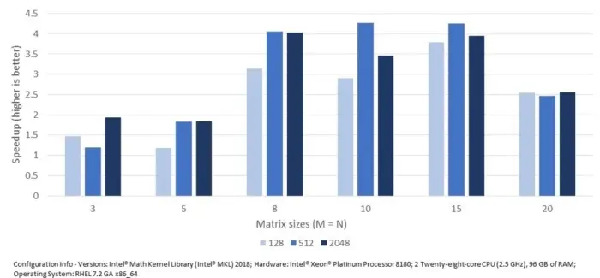
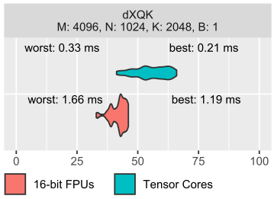
Data Movement Is All You Need: A Case Study on Optimizing Transformers [1]
III. Solutions
3. Data layout selection
Performance
Data layout and performance
Operator
M, N: size of matrix; K: output sequence length; B: batch size.
Figure source: [9]
Different data layouts
* Better performance with Tensor Cores.
Tensor Cores enable mixed-precision computing, dynamically adapting calculations to accelerate throughput while preserving accuracy. The latest generation of Tensor Cores are faster than ever on a broader array of AI and high-performance computing (HPC) tasks. [10]
% peak performance
* Width of the Violin plots shows that larger number of configurations may not result in better performance.
* Performance of different data layouts also depend on hardware specifications
[9] https://www.infoworld.com/article/3257770/understanding-why-data-layout-matters.html
[10] https://www.nvidia.com/en-us/data-center/tensor-cores/

Slide 8
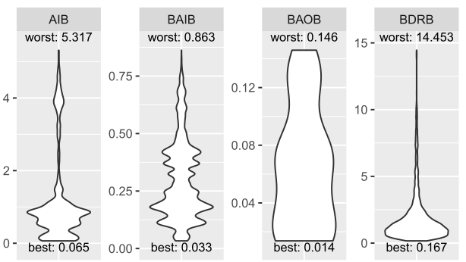
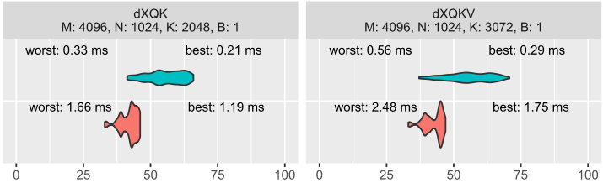
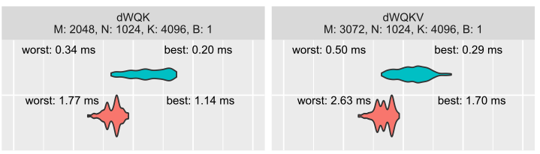
Data Movement Is All You Need: A Case Study on Optimizing Transformers [1]
III. Solutions
3. Data layout selection
For each operator (tensor contractions and fused operators), benchmark every feasible data layout (all equivalent permutations), as well as varying other parameters depending on the speciﬁc operator.
Data layout selection is particularly impactful for normalization and tensor contraction operators, where it provides opportunities for vectorization and different tiling strategies.
Tensor Contractions
Violin plots: the width represents the relative number of conﬁgurations with the same runtime.
Fused Operators
The most noticeable performance improvement is made by layouts that enable vectorized memory access, showing that the main performance limitation is the amount of moved data. The second notable category are layouts with the same reduce and vector dimensions.
Note that, the performances of Tensor contraction performance are shown in as % values.

Slide 9
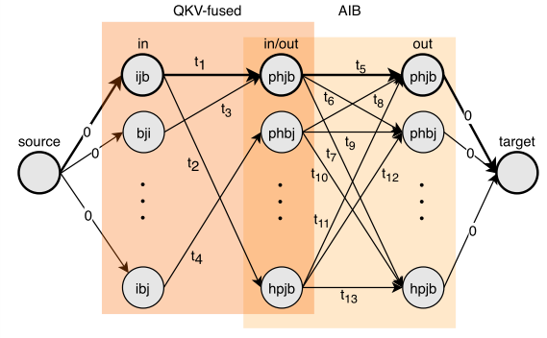
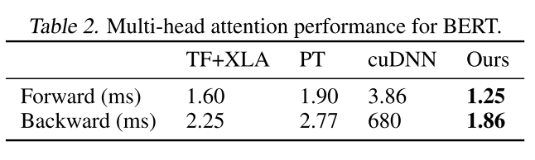
Data Movement Is All You Need: A Case Study on Optimizing Transformers [1]
III. Solutions
4. End-to-end optimization
Example:
Automatic conﬁguration selection algorithm:
Add a node to the graph for each input and output data layout of the operator.
Add an edge from the input to the output layout, weighted with the minimum runtime of any conﬁguration with that layout.
Run a single-source shortest-path (SSSP) algorithm from the input to the output in the graph, and the resulting path is the ﬁnal conﬁguration.
Because the graph is a directed acyclic graph (DAG) and the number of feasible input/output conﬁgurations for each operator is small, so SSSP takes linear time asymptotically and seconds for BERT.
QKV-fused: three input tensors queries (q), keys (k), and values (v) fused.
AIB: Attention input bias.
Comparison [1]

Slide 10
Data Movement Is All You Need: A Case Study on Optimizing Transformers [1]
III. Solutions
4. End-to-end optimization
A (fused) operator
Definition: Single-source shortest-path (SSSP) algorithm: for a given single vertex v (source), find the shortest path to the target in the graph.
Example:
In the figure, let the numbers in red and yellow be the time needed to process an operator from data input to data output.
The red path is “shorter” than the yellow one ((5+1)<(4+10)).
Code: the Dijkstra’s Algorithm in [12]
5
1
10
4
Corresponding performance (in time)
* QKV-fused: three input tensors queries (q), keys (k), and values (v) fused.
* AIB: Attention input bias.
[12] https://www.techiedelight.com/single-source-shortest-paths-dijkstras-algorithm/
Different data layouts and sizes

